Slide 1
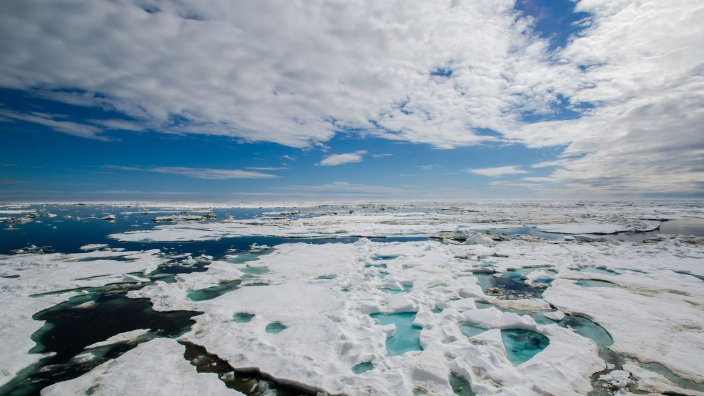
Weather Project
Alana, Leo, Zack

Slide 2
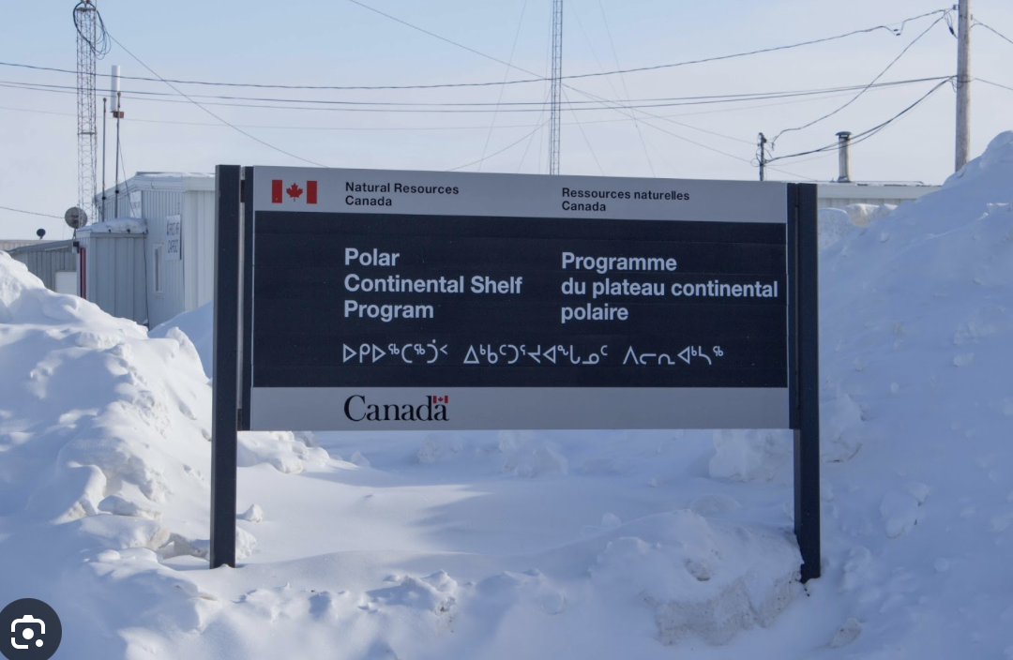
Introduction
Polar Continental Shelf Program (PCSP)
Natural Resources Canada (NRCan)
What they do:
Logistical support for projects
Support field work in northern regions
Provide aircraft support

Slide 3
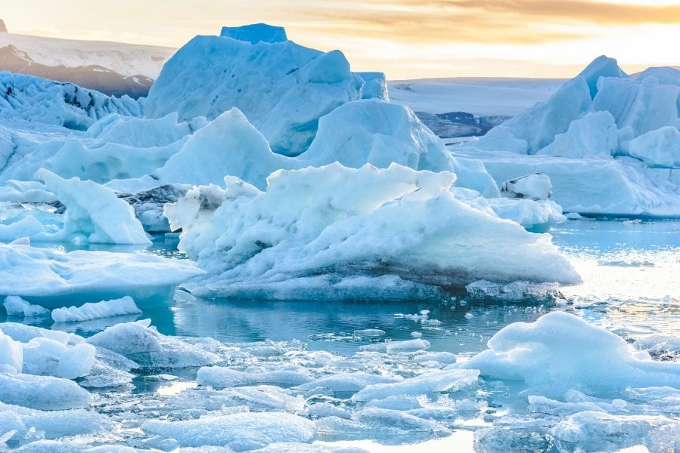
Purpose:
Develop a script that automates downloading near real time (NRT) satellite imagery over an area of interest
Scope:
Downloads most recent imagery from MODIS terra and aqua satellites
Composites imagery and converts to viewable image to be opened in QGIS
Task scheduler so imagery can be instantly accessed
Image: Authors, Wire., & Francis, J. (2017, June 9). Amplified arctic warming and mid-latitude weather: New Perspectives on Emerging Connections. Advanced Science News.

Slide 4
Importance
Monitor weather conditions to enable safe operations
Frequent and severe weather changes in arctic
NRT satellite imagery is best way to monitor weather

Slide 5

Install/Packages
Download Anaconda
Install environment
Packages:
earthaccess - NASA Earthdata API access
GDAL (with HDF4 support) - Geospatial processing
geopandas - Geospatial data handling
numpy - Numerical processing
Other supporting libraries
Notes:
Anaconda: to run python
Environemnt to ensure all packages and tools are downlaoded and fuctional
GDAL = reading and writing raster (grid) files and tiff format

Slide 6
Workflow
Login to NASA Earthdata
Search for MODIS imagery over the area of interest
Download and process images
Open Images in QGIS and apply RGB and false colour
Cleanup files
Create composite
Z
Notes:
log in to nasa portal of data
Composite to stitch together files to cover AOI
QGIS is open source to visualise it

Slide 7
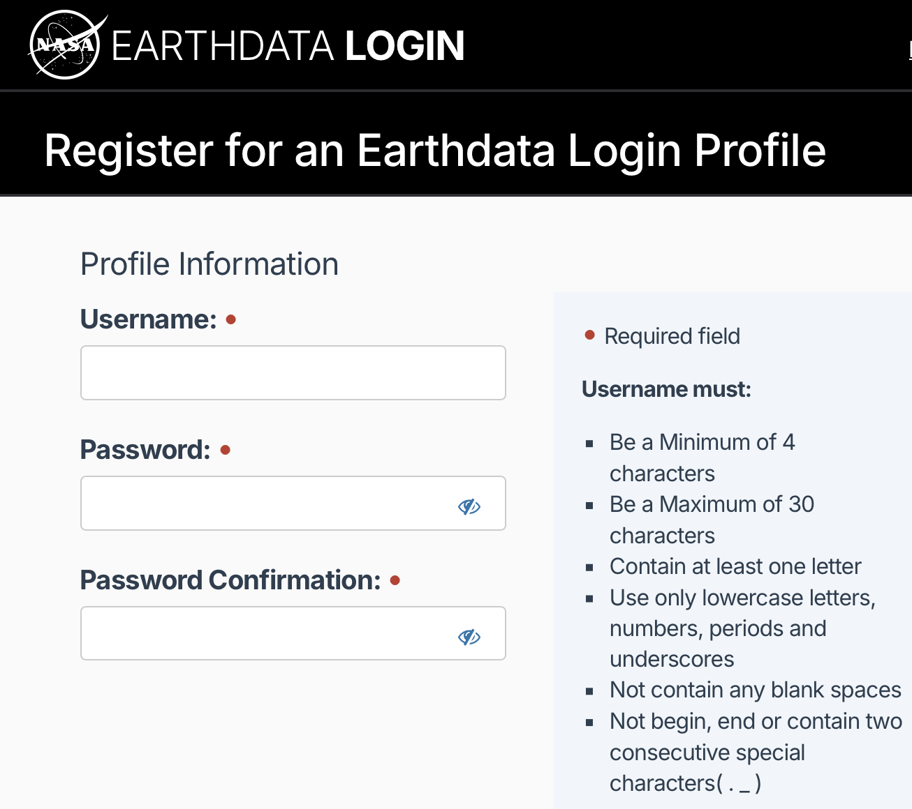


Documentation – NASA Earthdata
Create account
Change login credentials in code
Z
Notes:
How to Create an Account
Free on NASA website
How to change the Code
Replace quotes with created username and password
Hard code

Slide 8
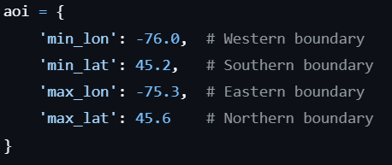
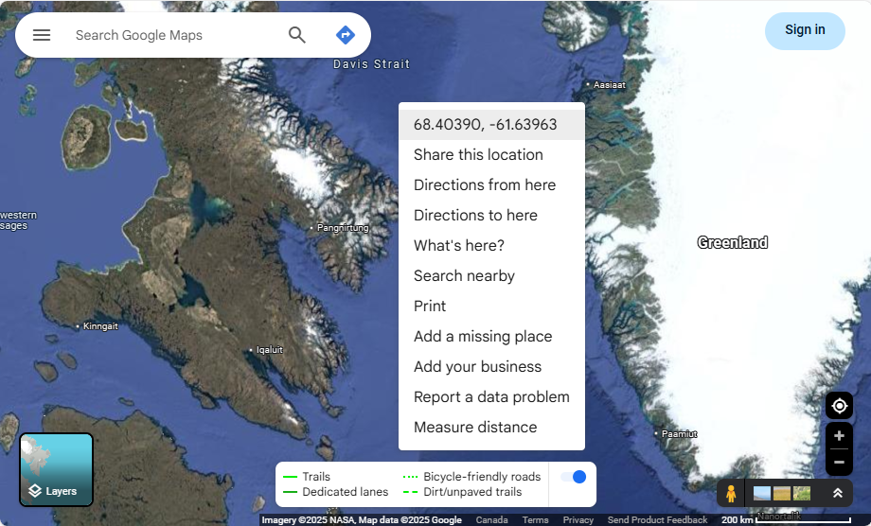
Documentation – Area of Interest
Area of Interest can be changed in code
Coordinates found by right clicking in Google Maps
For Canada: negative values are longitude and positive values are latitude
Smaller value equates to minimum values

Slide 9
Documentation – Functions
verify_credentials
successfully logs into Earthdata with hard coded username and password
get_modis_imagery
find imagery for given AOI and time
download_and_process_image:
download, process, and project image
Notes:
verify_credentials()
No arguments
Outputs
authentication object for earthaccess.login
get_modis_imagery()
get_modis_imagery()
4 floats (min and max, lat and lon)
Float for time offset
String for resolution (Accepted values are "QKM", "HKM", or "both")
Returns 3 lists
List of granule objects
A list of strings representing the product types
A list of datetime objects extracted from the metadata
download_and_process_image()
Arugu

Slide 10
Documentation – Functions
cleanup_files
remove temporary files, only keep tiff files
create_multi_band_composite
combine bands from QKM and HKM into single tiff

Slide 11
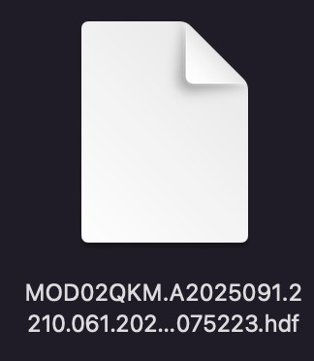
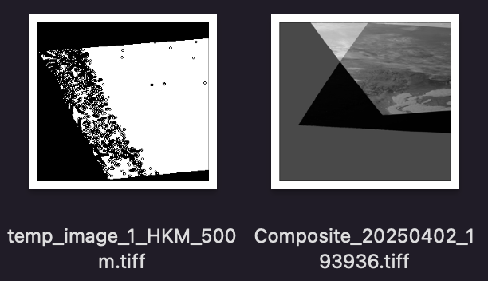
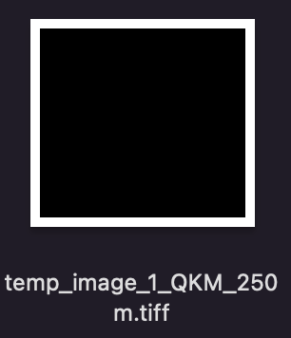
Documentation – Output
Hierarchical Data Format (HDF) file
Temporary images – HKM (half-kilometer) and QKM (quarter-kilometer)
spatial resolutions of MODIS data, HKM is 500 meters and QKM is 250 meters
Composite

Slide 12
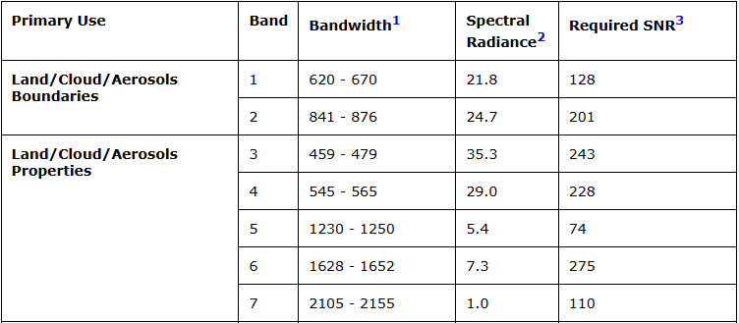
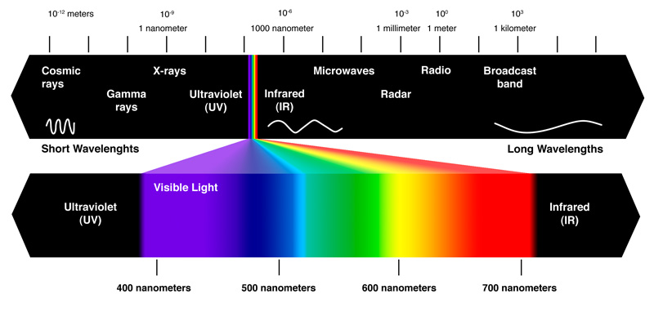
Composite Output
Tagged Image File Format (tiff) containing the following bands

Slide 13
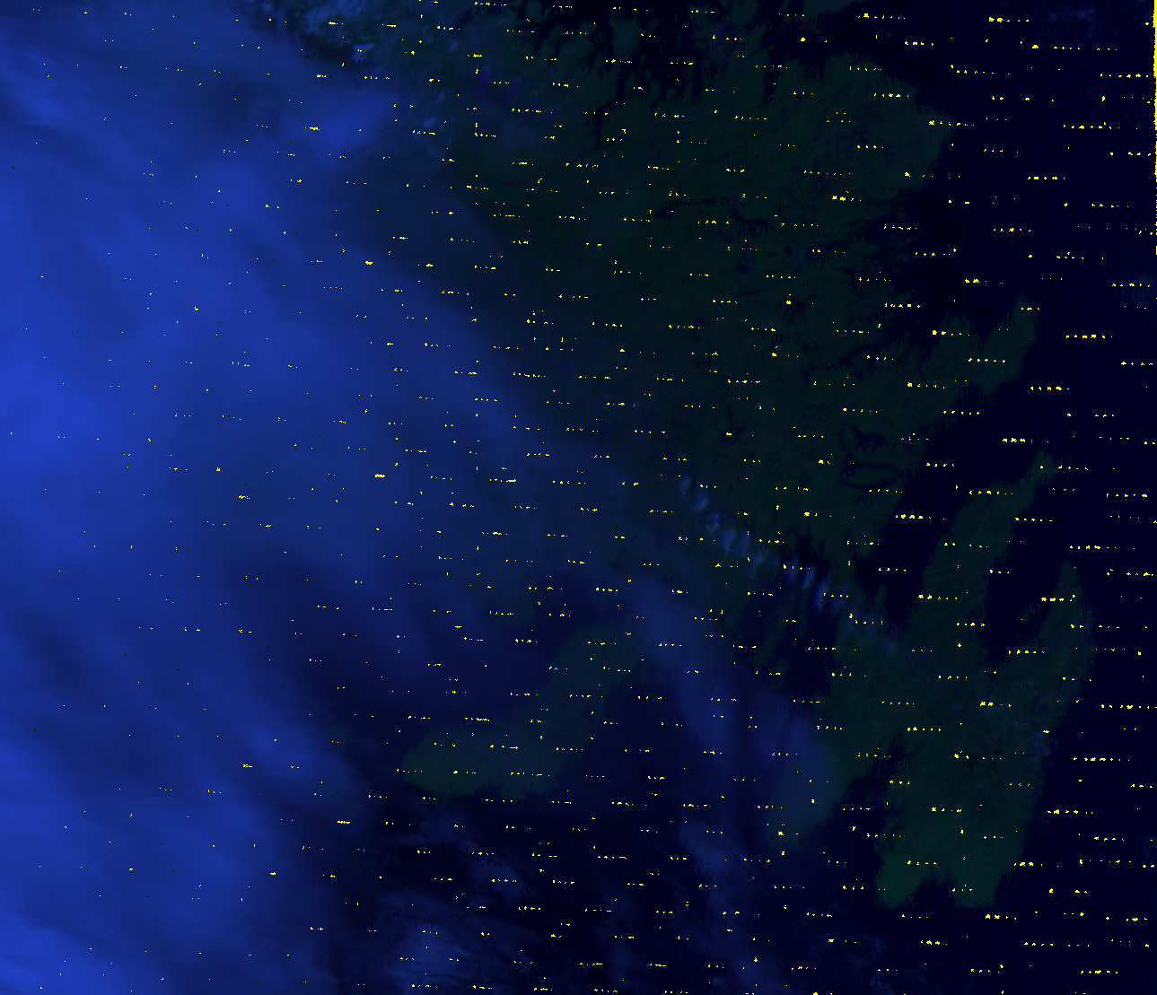
Results
Downloads Near Real Time (NRT) imagery
Produces viewable image over AOI (Newfoundland)
No Visualization Modifications

Slide 14
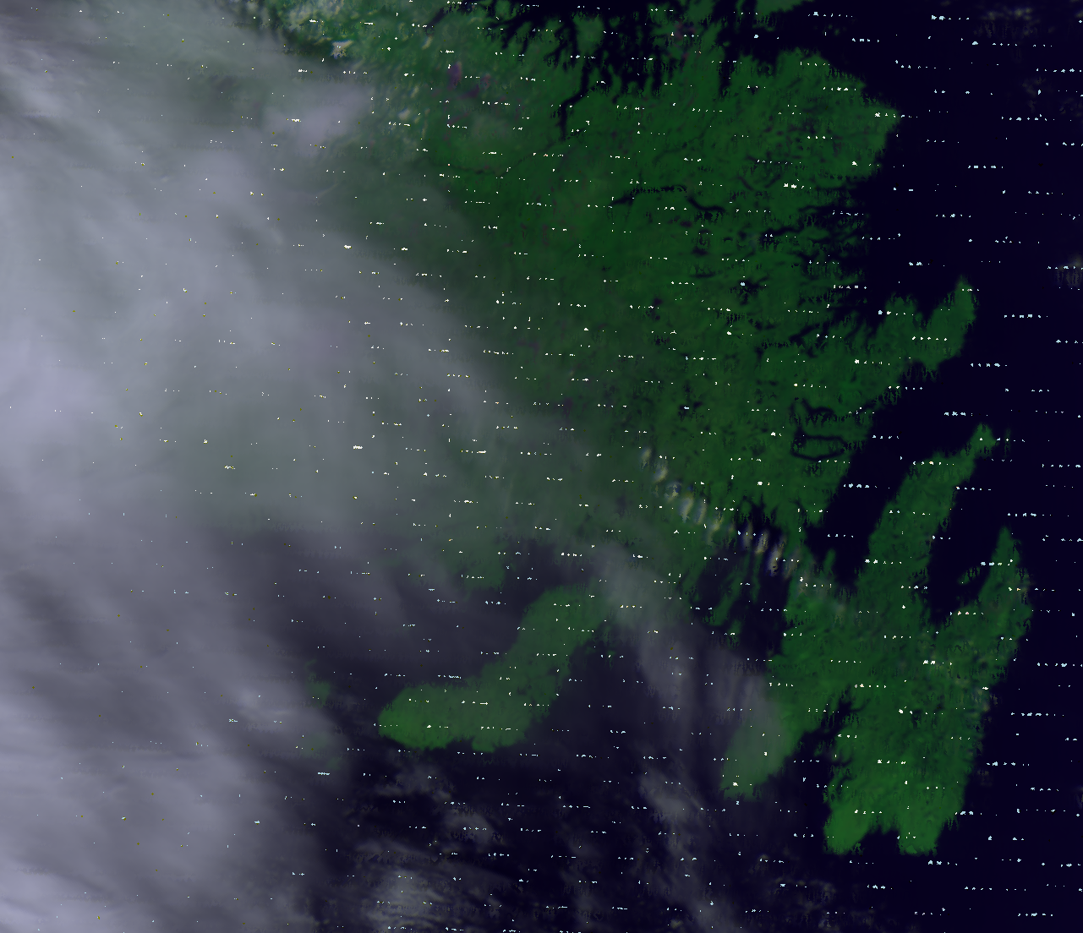
True Colour
RGB bands
QKM Band 1 (Red)
HKM Band 2 (Green)
HKM Band 1 (Blue)

Slide 15
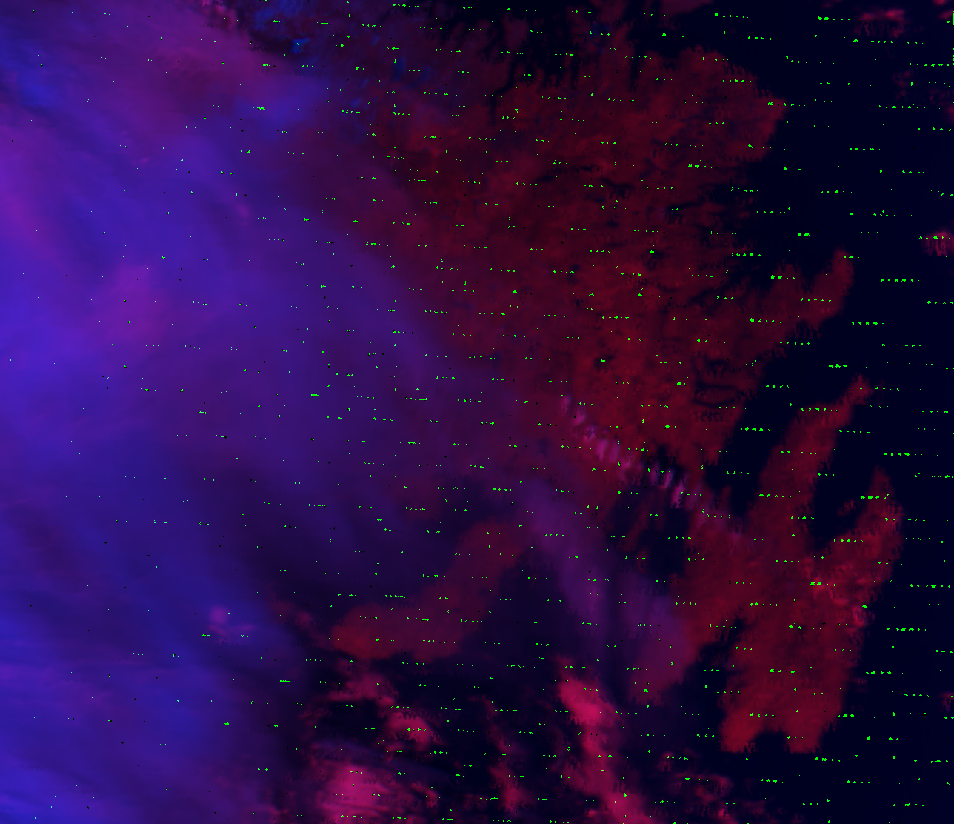
False Colour
Bands
HKM Band 4 (SWIR2)
QKM Band 1 (Red)
HKM Band 2 (Green)

Slide 16
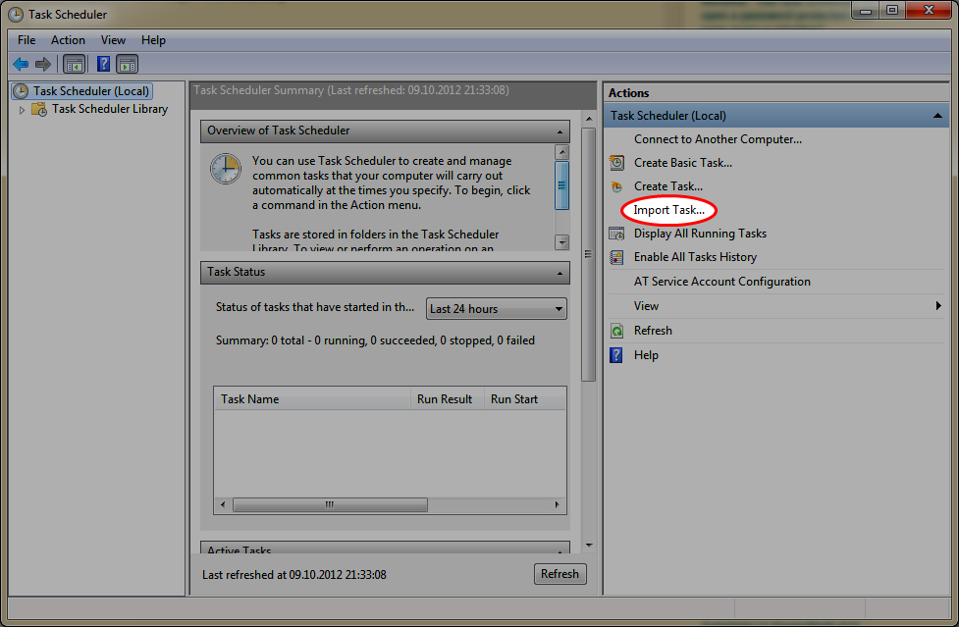
Use Case #1 – Automatically Downloading
Automate process to run in the background
Import file in Windows Task Scheduler (.XML file)
Execute python script at pre-set intervals e.g. hourly

Slide 17
Use Case #2 – Retroactive Approach
Download all the images that were taken in the past 48 hours
Code to change: get_modis_imagery (hours_ago = 48)
Pros | Cons
Automation not required | Long processing time
Only runs when needed | Possibly too many images
Easier error debugging | Images not instantly accessible

Slide 18
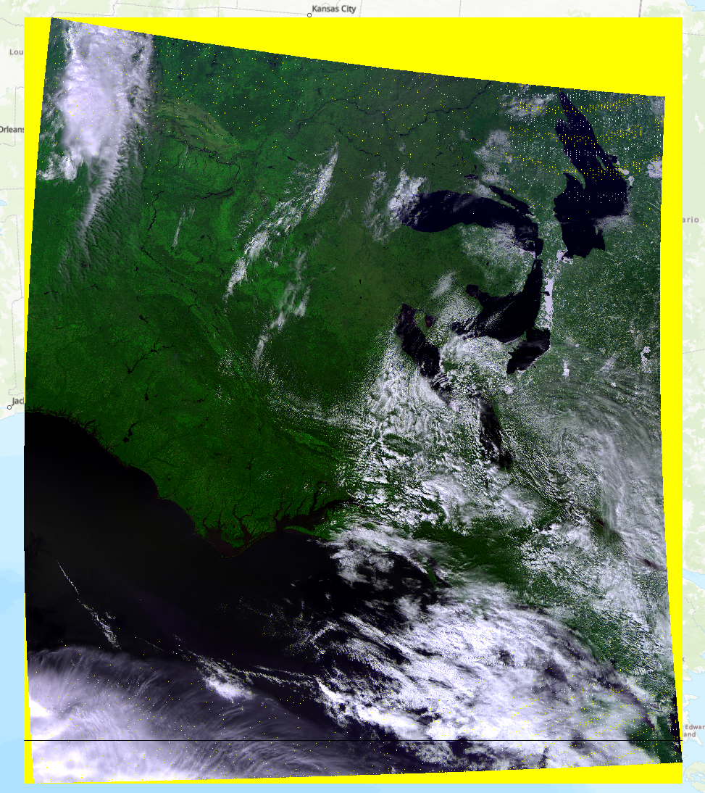
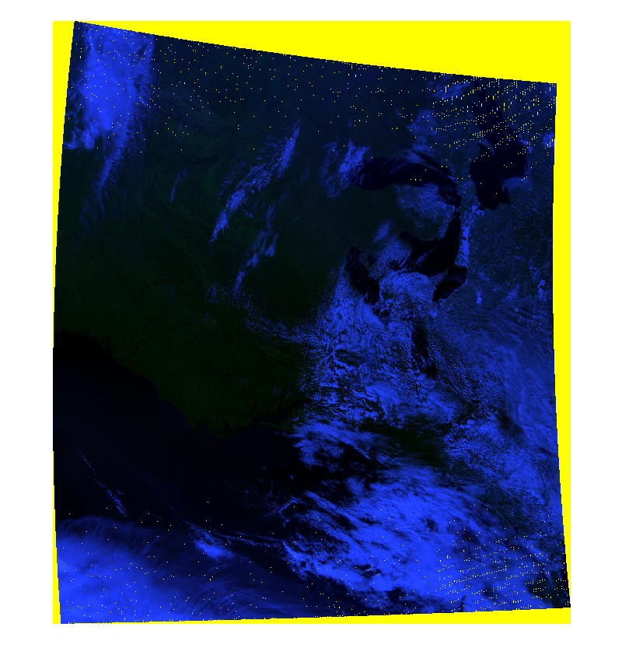
Challenges / Limitations
Required bands on different sensors
Different resolutions on sensors
Large images require long processing times
Real time challenges
Symbology
Percent Clip in ArcGIS is very difficult to recreate in QGIS
Image in ArcGIS Pro
Image in QGIS
Notes:
Processing one image – through the whole script takes approx 5 minutes
No images in arctic in winter - we tested on Ottawa

Slide 19
Future Work
Improve processing
Adding auto cleaning up
Delete files after set amount of time (older than 1 week)
Automatic symbology
Apply correct visualization when added to QGIS
Notes:
Further reduce the processing time
Make the output file sizes smaller
This could allow for Scaling up AOIs

Slide 20
Acknowledgments
Derek Mueller
Tanya Lemieux
NASA for free access to MODIS satellite imagery
GDAL developers for the geospatial processing library
The earthaccess library for simplified Earthdata access
Claude.ai for troubleshooting

Slide 21
Questions?

